Slide 1
Where to get help

Slide 2







Adviser Distribution team
Carson McNamara
National Manager, Adviser Distribution
The team includes Adviser Distribution & Account Managers:
Tim Berkman
QLD & NT
Ike Petroski
NSW & ACT
Nikki Spiers
VIC & WA
Peter Reynolds
VIC, SA & TAS
Claire Coyle
NSW
Peter Bekavac
Australia wide
Notes:
What they do
Fund and Product experts who develop and maintain one-on-one relationships with external licensees and advisers who partner with us
Objectives
increase the number of new members joining the Fund on the recommendation of an Adviser
retain members under advice by moving from Accumulation to the Choice Income (retirement) phase

Slide 3
Help and advice
Online
australiansuper.com
Financial advice meeting*
1300 300 273
Over the phone*
1300 300 273
Find an adviser tool
findadviser.australiansuper.com
*Personal financial product advice is provided under the Australian Financial Services License held by a third party and not by AustralianSuper Pty Ltd. Some personal advice may
attract a fee, which would be outlined before any work is completed and is subject to your agreement. With your approval, the fee for advice relating to your AustralianSuper account
may be deducted from your AustralianSuper account subject to eligibility criteria.
Notes:
AustralianSuper aims to provide help and advice to members as they need it. And We do this in 3 main ways.
Online via our website, which has a range of tools and calculators, and information about AustralianSuper and super in general.
We also offer our members access to financial advice over the phone with qualified financial planners who can help you with single issue advice about your AustralianSuper account, such as contribution advice or maybe how my super should be invested or even how much insurance should I have.
This advice is provided at no additional cost to members - its cost is included in the member fee that we all pay. So I would suggest that to get best value from your AustralianSuper membership it makes sense to seek advice as you need it.
I will just note that phone advice for retirement or transition to retirement has a small fee.
For those members that would prefer to meet with an adviser, or maybe have more complex issues, AustralianSuper also offers access to financial planners based in our offices around Australia. This advice is usually provided with face to face meetings, or virtual internet based meetings. This financial advice service is at members own expense.
You can also access advice in your local area with a registered financial adviser. You can find all of the advice options through our find an adviser tool.

Slide 4

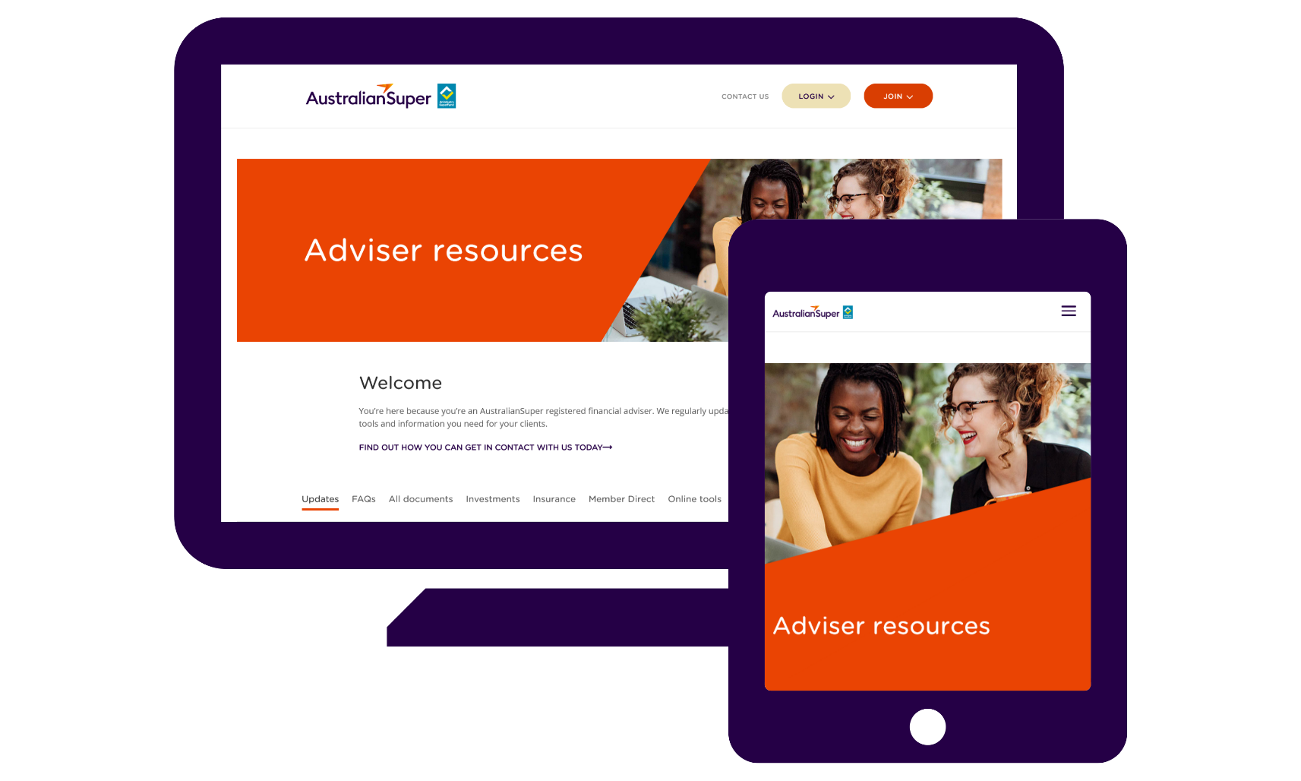
Adviser resources site
australiansuper.com/AdviserResources
Notes:
A tools and resources site for our Adviser network, that includes forms,
fact sheets, PDSs, join forms, investment information and more:
australiansuper.com/AdviserResources

Slide 5


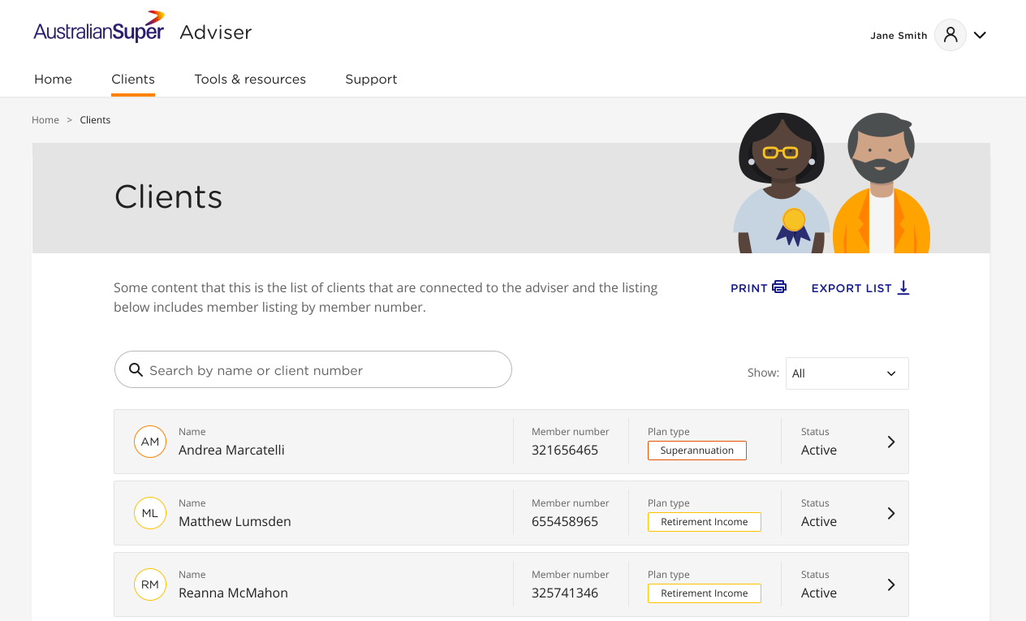
Adviser resources site
adviser.australiansuper.com
Notes:
The Adviser Portal allows you to view key information on your AustralianSuper client’s accounts (Accumulation & Choice Income) and create new account based pension accounts (Choice Income or TTR Income) for your clients where a valid authority has been provided, including:
current account balance (including benefit & withdrawal estimates)
contact details
transactions from the past three+ years
summary of investment balances and future investment allocations
insurances (if applicable)
beneficiaries.
Concessional /Non-Concessional summary - Yearly concessional and non-concessional contribution totals are now calculated and displayed under a client’s profile.
Centrelink Schedules – Advisers can now generate a PDF copy of a Centrelink Schedule from the Portal.
Pension payment details - Retirement accounts will now include the following details: Minimum pension payable, maximum pension payable, indexation factors, payment frequency, payment type and payments received FY to date.
Custom date ranges on client transaction history page – Advisers can now select custom start and end dates (no more than 12 months).
You’ll also be able to extract key information (e.g. transactions) into Excel for further analysis, or extract a Member Profile Report which presents all key information in a standard and professional format.
To access the Portal at adviser.australiansuper.com, you’ll need to contact the Adviser Services team for your login details.

Slide 6

Support for you

Slide 7

Visit australiansuper.com/AdviserResources
for the latest on:
  Investment options
  Performance
  Insurance
  Fees
  Latest updates

Slide 8
It’s Australian.
It’s super.
And it’s yours.

